Slide 1
Analysis of Forest Fires Around Caldwell and Economical Impacts
Aditi Kharkwal

Slide 2
Goal of the Project
Analyze the following:
Total forest fires occurring every 50 mile distance from Caldwell.
Total acres burnt per year for the last 60 years.
Estimate the smoke impact of wildfires around Caldwell for the last 60 years
Predict the smoke estimates for the next 25 years
Scaled AQI vs. Scaled Own Smoke Estimate Over Time
Evaluate the impact of Wildfires on Economy:
Impact on Occupation
Impact on Employment
Impact on Earnings

Slide 3
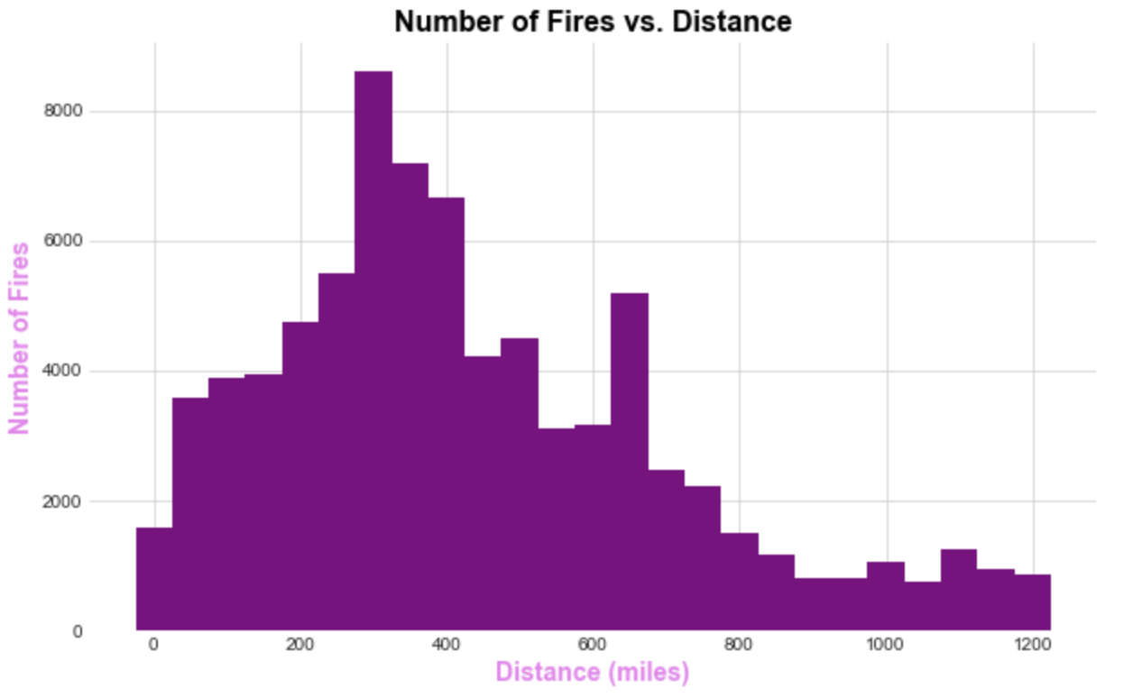

Slide 4
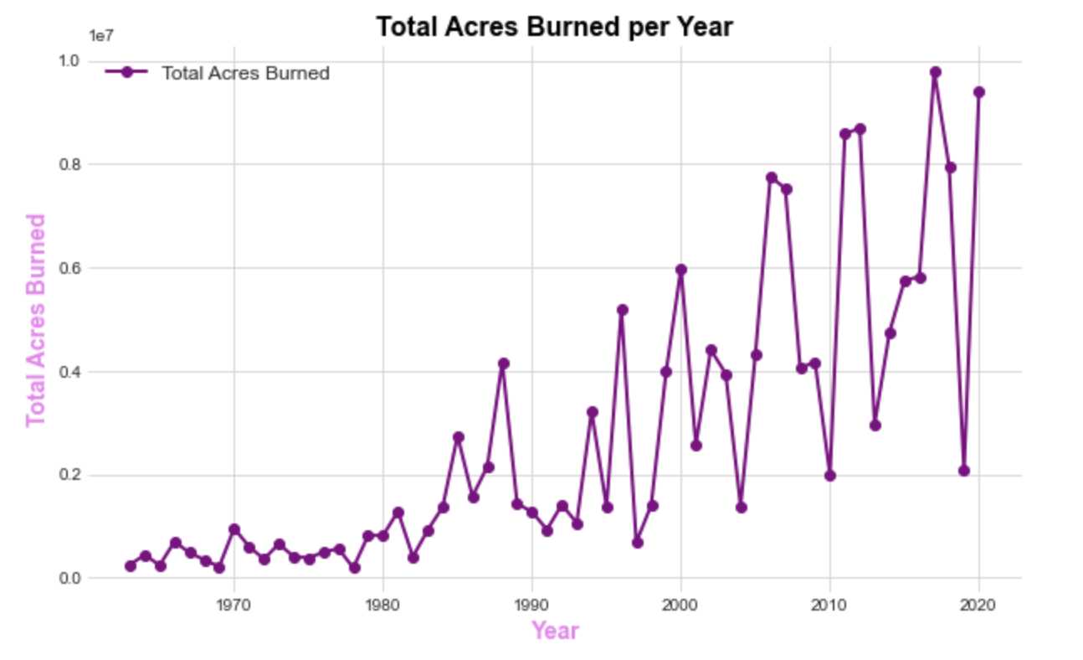

Slide 5
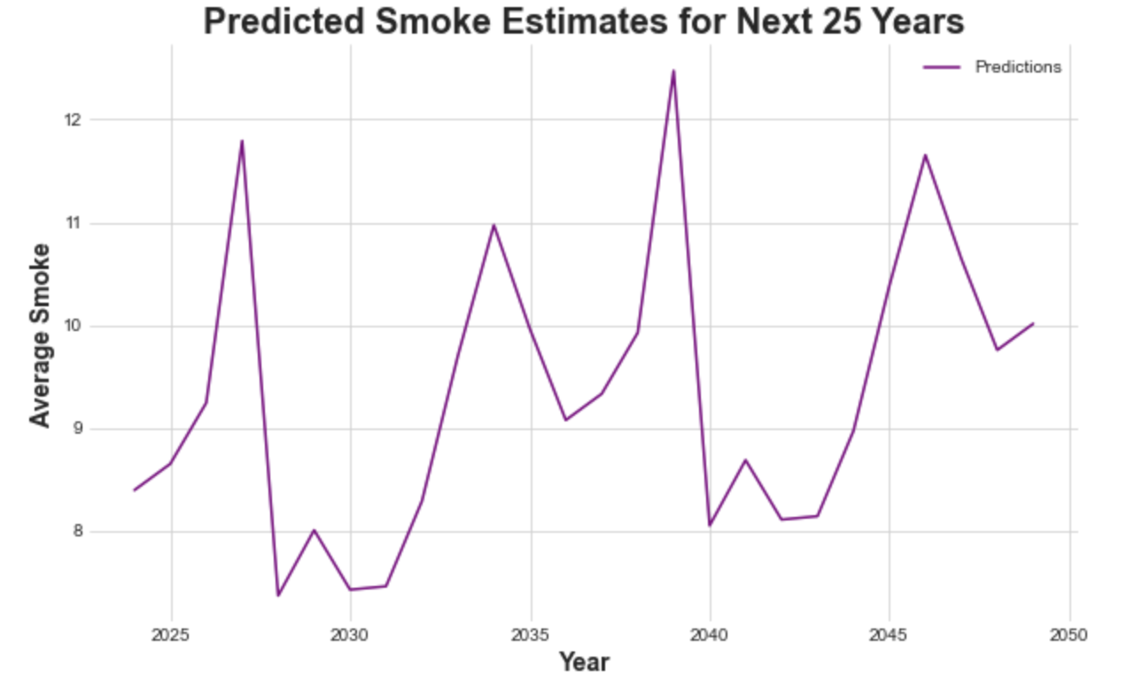

Slide 6
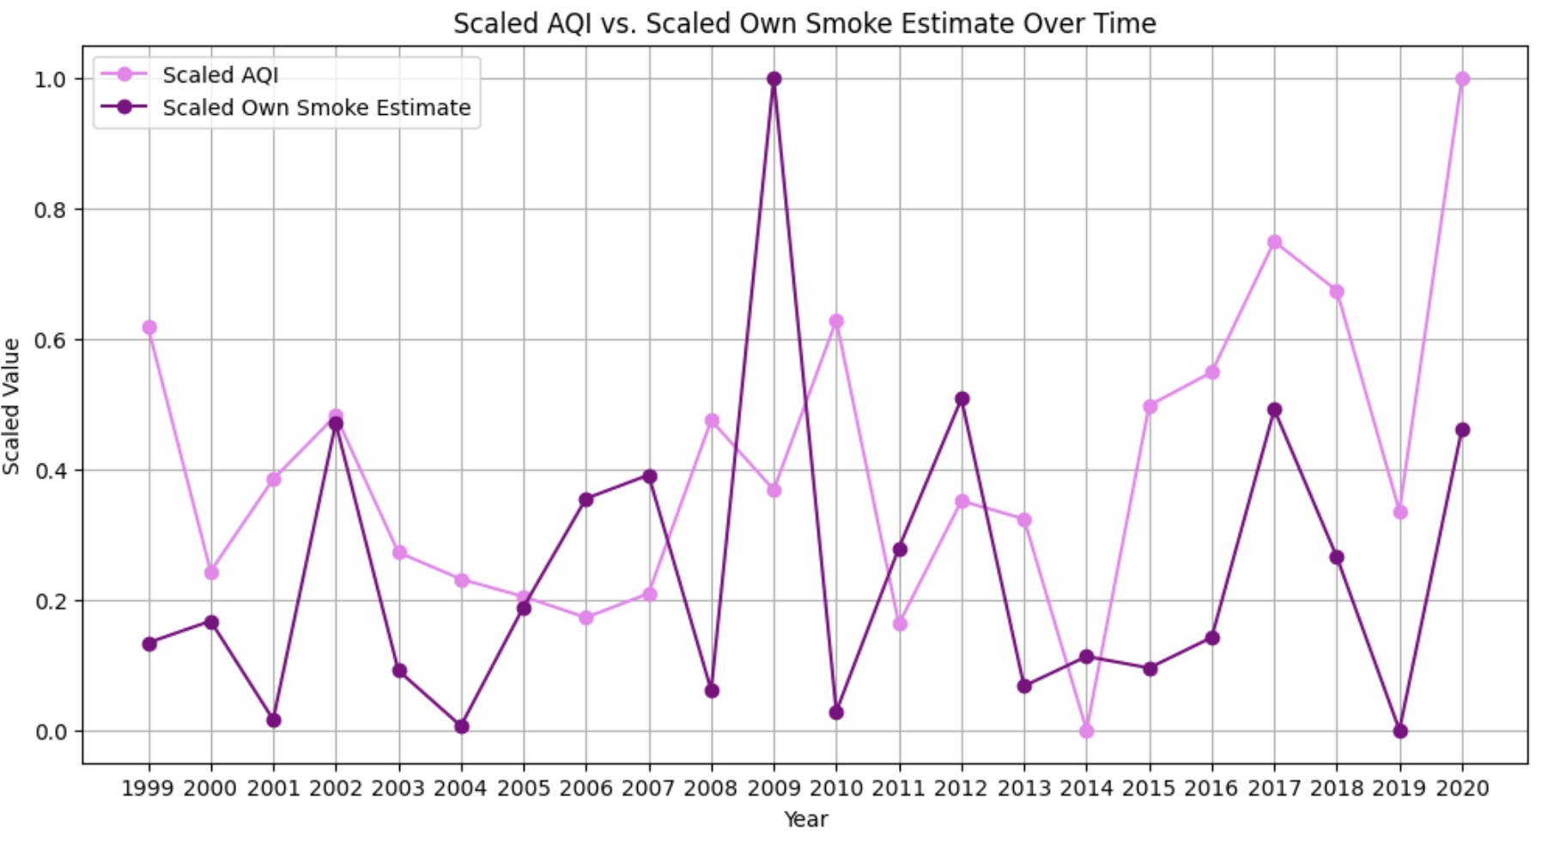

Slide 7
Economical Impacts:
For Wildfires impact on Economy related to forestry, farming, healthcare industry and fire prevention I collected data from datausa.io from 2013 till 2021.
The 3 main areas in economy where I analyse the correlation are:
Occupations in forest departments and fire departments
Occupations in health care sector
Employment in the agriculture and healthcare departments

Slide 8
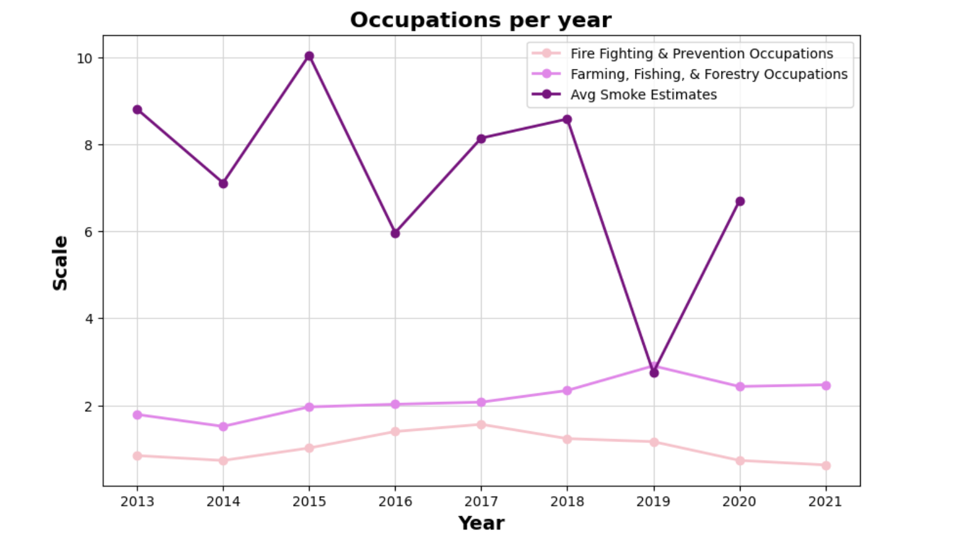
Correlation coefficient with fire fighting and prevention occupation:
0.07142857142857142
Correlation coefficient with farming, fishing and forestry occupation: -0.6299598265532013

Slide 9
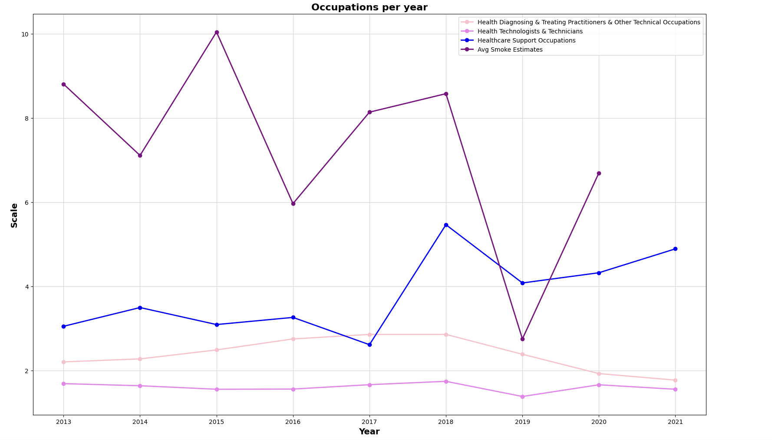
Correlation coefficient with
Health Diagnosing & Treating Practitioners & Other
Technical Occupations:
0.1609952686653771
Correlation coefficient
with Health
Technologists & Technicians: 0.7120469180865839
Correlation coefficient
with Healthcare Support
Occupation:
0.01543369060321145

Slide 10
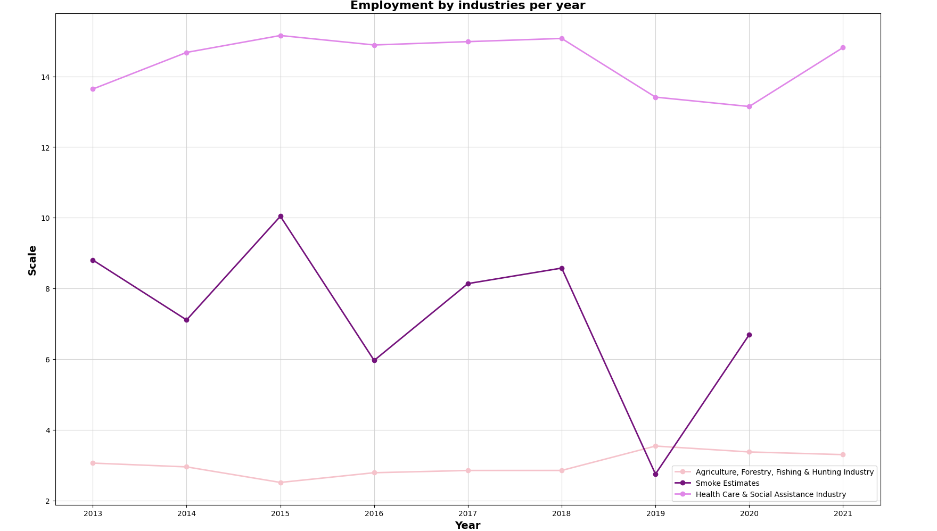
Correlation coefficient
with Agriculture,
Forestry, Fishing & Hunting Industry:
-0.7654506706434657
Correlation coefficient
with Health Care &
Social Assistance Industry: 0.5264881029550378

Slide 11
3 key takeaways..
1
Increase in Wildfires
2
AQI vs smoke correlation
3
Economy impacts
The wildfires are increasing every year:
Increase in land burnt
Increase in smoke
Increase in forecasted wildfire smoke
As the smoke increases the AQI in the county increases likely to cause several problems:
Health Issues
Economical Impacts
Shift in population and housing situations
The main economy is getting affected in the Healthcare sector.
Farming, forestry and fishing related occupations also decrease as smoke increases.

